Slide 1



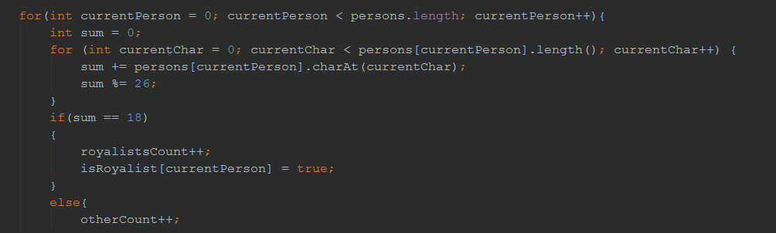
Java Advanced
Course Introduction
Java
SoftUni Team
Technical Trainers
Software University
http://softuni.bg

Slide 2
Questions
sli.do #7334

Slide 3









SoftUni Diamond Partners

Slide 4
Java Web Profession
Java Fundamentals Module
Java Advanced Course
~9,000,000 Developers Worldwide
~700 Offers @ Jobs.BG
Scope
Trainers
Evaluation

Slide 5
Java Web Profession
Java Fundamentals Module
Java Advanced Course
Algorithmic and Conceptual Courses
Prelude to Database and Web Technology Courses
Scope
Trainers
Evaluation

Slide 6
Java Web Profession
Standard Java API
Java Fundamentals Module
Algorithmic thinking
Java Advanced Course
Scope
Trainers
Evaluation

Slide 7

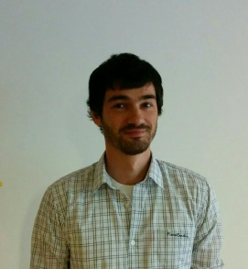


Java Advanced Course
Scope
Trainers
Evaluation

Slide 8
Trainers
Ivan Yonkov
Training Lead & Trainer @ SoftUni
5 years of programming experience mainly with Java and PHP
Solid experience as QA engineer
Top performing student from the Software University (2014)

Slide 9
Trainers
Peter Penev
Technical Trainer @ Software University
Top performing student from the Software University
Deep interest in Data Structures & Algorithms

Slide 10
Trainers
Stanislav Petrov
Technical Trainer @ Software University
Top performing student from the Software University
Interest in web development technologies

Slide 11
Trainers
Todor Ilchev
Technical Trainer @ Software University
Top performing student from the Software University
Graduated Business Informatics

Slide 12
Trainers
Java Advanced Course
Scope
Evaluation

Slide 13
Examination
Activities
Bonuses
Forum Activity
Nested Linear Structures
Attendance
Algorithmic Problem
Java Advanced Course
75%
25%
10%
Nested Data Structures
10%
String Processing
Scope
10%
5%
Trainers
Evaluation
Teamwork Project
Exercises
Labs

Slide 14
Java Web Profession
Java Fundamentals Module
Java Advanced Course
Scope
Trainers
Evaluation

Slide 15


Your RFID Chip
Students can either
Take RFID chip from SoftUni
Or use their own chip / card
Register your chip number in your SoftUni profile: https://softuni.bg/users/profile/show
Check-in at the reception every time when you come
See your last visits in your profile: https://softuni.bg/users/profile/show

Slide 16









Resources
What We Need Additionally?

Slide 17

Course Web Site & Forums
The Java Advanced official web page:
Register for the "Software University Forum":
Discuss the course exercises with your colleagues
Find solutions for all course exercises
Share source code / discuss ideas / help each other
https://softuni.bg/courses/java-fundamentals
http://softuni.bg/forum

Slide 18



The Java Advanced Slides and Videos
All lecture slides, videos, exercises, projects and other resources are open content, available for free
Visit the course web site to access the course resources

Slide 19
The Free Java Fundamentals Textbook
The official textbook for the course
„Въведение в програмирането с Java", by Svetlin Nakov & Co., 2009, ISBN 9789544000554
Bulgarian versions (as PDF, ePub, …)
Freely downloadable from: www.introprogramming.info

Slide 20


Required Software
Software needed for this course:
Microsoft Windows (Win 10 / 8.1 / Win8 / Win7)
JetBrains IntelliJ Idea
JDK 8 (Java Development Kit)

Slide 21

Java Advanced – Course Intro
https://softuni.bg/courses/java-fundamentals

Slide 22
License
This course (slides, examples, demos, videos, homework, etc.) is licensed under the "Creative Commons Attribution-NonCommercial-ShareAlike 4.0 International" license
Attribution: this work may contain portions from
"Fundamentals of Computer Programming with C#" book by Svetlin Nakov & Co. under CC-BY-SA license

Slide 23






Free Trainings @ Software University
Software University Foundation – softuni.org
Software University – High-Quality Education, Profession and Job for Software Developers
softuni.bg
Software University @ Facebook
facebook.com/SoftwareUniversity
Software University @ YouTube
youtube.com/SoftwareUniversity
Software University Forums – forum.softuni.bg

